Slide 1



CPOL Antenna and DTMF Control Capstone Senior Design Project March 25th, 2015
Tim Bodkin
Kevin Helms
Chris Tatosian
Luis Ceja Quiroz

Slide 2
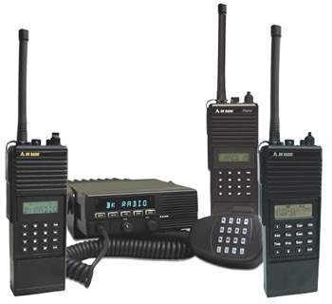
Problem Statement
Problem
Local terrain degrades the signal integrity of the UCSC repeater
Solution
We will improve the reception by creating a circularly polarized antenna

Slide 3
Project Requirements
Circularly polarized antenna array
DTMF controller
Antenna switching circuit
RoIP nodes
Audio linking Interface
3

Slide 4
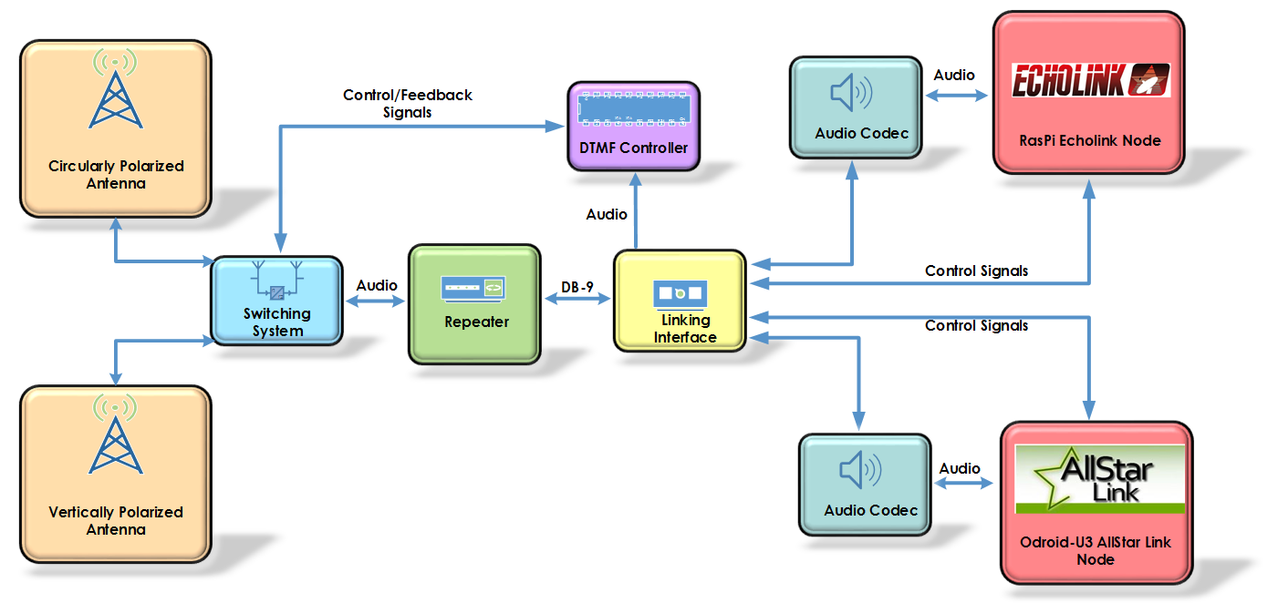


System Level Block Diagram

Slide 5
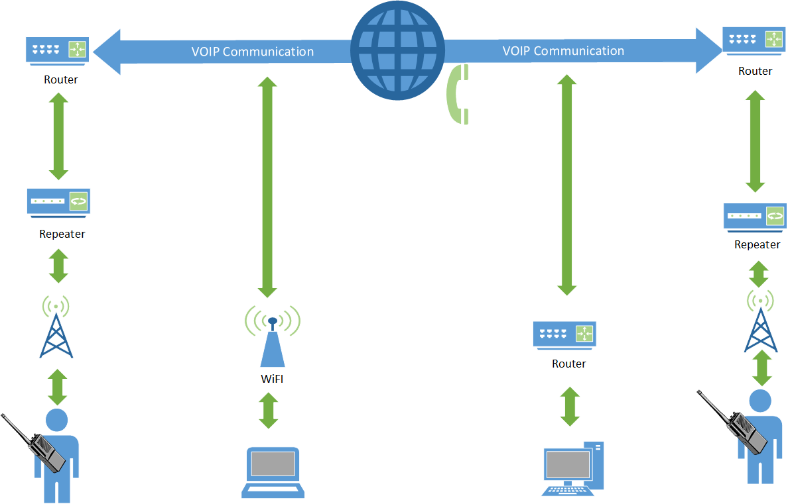
Radio over IP System Diagram

Slide 6
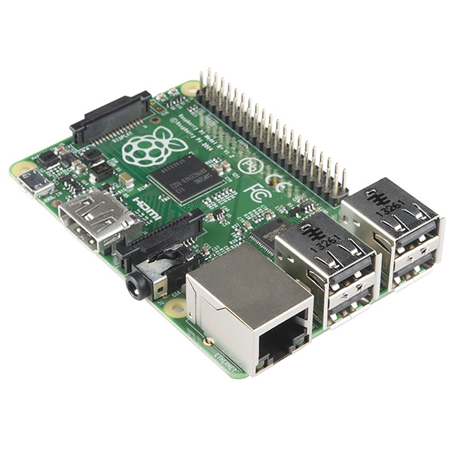
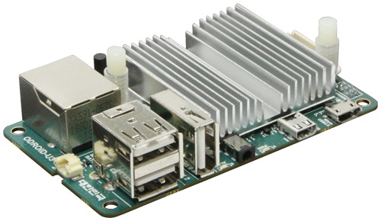
Implementation Details
Audio Linking Interface
Interface between RoIP systems, DTMF controller, and repeater
Audio mixing circuit
Audio distribution amplifier
Handles control logic between RoIP nodes
Echolink Node
Raspberry Pi
CM-108 USB audio codec
Allstar Link Node
Odroid U3
Asterisk VOIP protocol
CM-108 USB audio codec
Raspberry Pi
Odroid U3

Slide 7
Implementation Details
Antenna
Copper tubing
Circular polarization
High gain & axial ratio
Balun
Impedance matching network
DTMF Controller/Switching Circuit
Atmega 328
Wireless antenna selection via DTMF sequences
Switch between newly designed and existing antennas

Slide 8
Winter Quarter Results
Accomplishments:
Antenna prototype
Switching circuit prototype
Echolink node
DTMF Controller Design
Linking Interface Design
Spring quarter:
Finish prototyping
Test modules
Finalize designs
System integration

